Slide 1
Bringing nothing to the party
Vincenzo Iozzo
Director of Security Engineering
Trail of Bits, Inc
Notes:
Goals of the talk are:
1)analyze the current state of affairs and reasons on why AppSec is still a cost-center rather than a profit-center.
2) Make AppSec understandable to the lay-person
3) Force accountability in AppSec

Slide 2
It’s about time we make AppSec understandable to the lay person (read: your executives)

Slide 3
There’s no real accountability at company-wide level for AppSec, this has to change

Slide 4
Games we play these days..
Notes:
Let’s see why we haven’t fixed yet the two problems above

Slide 5
Fail to separate threats
Notes:
The complexity of both offensive capabilities and defensive abilities is completely lost on most people (especially outside of the industry)
Attacks against sophisticated entities should be used as benchmark for what is hard
More sophisticated attacks are not just advanced versions of the the bread and butter hacks

Slide 6

Compare and contrast
Notes:
Far too often we forget that the sophistication of certain attacks is on a totally different level compared to the means available to casual attackers.
Exploits kits have very lame mem-corruption bugs that only work for Win XP and Java logic bugs. That’s it.

Slide 7
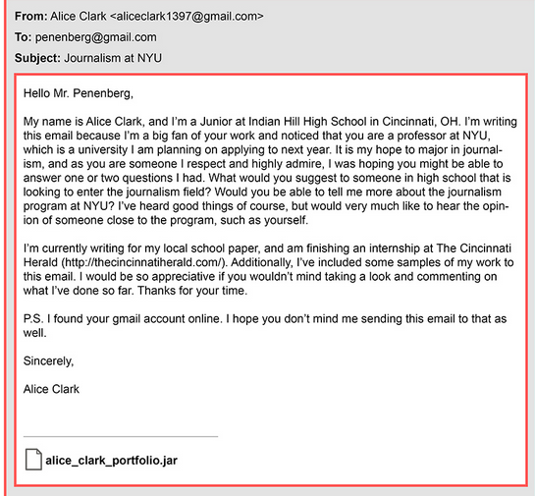
And this..
Notes:
NYU professor asked SpiderLabs to show their ability to hack him.
The attack was successful due to a very basic phishing attack, this is not dissimilar from a lot of real-world scenarios
As an aside, Maybe time to reconsider all the money spent on security awareness training? (it won’t work anyway, incentives for employees are just not there)

Slide 8
With this
Notes:
It’s not just cool toys toys/exploits it’s also about very different attack vectors.
What’s your plan to protect against these attack vectors?

Slide 9

Forget the good ol’weak links
Notes:
The other plague of InfoSec
Essentially, due to the natural interdependence of risk in the field the weakest link can be a dramatic problem for more advanced & savvy actors as well

Slide 10
Macro-level example
Notes:
RSA and Bit9 were compromised through very basic phishing emails.
Consequence: ask any competent CISO to deploy your own security product on their network and look at their face.
This happens at all levels, e.g. AVs plugins for browsers were the last to be ASLR-enabled.

Slide 11
Eco101
Notes:
It makes sense to use a more rigorous framework to analyze these phenomena as it provides a better analytical option to tackle some of the issues

Slide 12

The market for lemons
Improper threat analysis and quality control leads to a market for lemons scenario
Notes:
Most people have no idea of what or who is after them.
Due to the weakest link problem the profile of the attack can change wildly
This creates the perfect opportunity for selling useless security solutions (see for instance the AV industry vs Stuxnet/Flame/etc)
The lack of data on the buyer’s side makes it almost impossible to evaluate the effectiveness of the acquired product

Slide 13
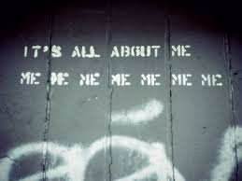
Free riders!
The careless employee/company is free-riding on somebody else’s security investment
Notes:
Again, the risk in InfoSec is interdependent.
If we perceive confidentiality and security as a ‘common resource’ (see tragedy of the commons), the entity that has the highest benefit-cost ration is the one who is going to pay the most.
Result: InfoSec naturally exposes itself to significant free-riding behavior.

Slide 14
Externality
Both internally and externally security is far too often an (good|bad) externality
Notes:
Unfortunately the inability to properly disentangle interconnected risks makes it very easy to perceive security (or lack of thereof) as an externality.
People are extremely adverse where it comes to losing, this also implies that good externalities are often overlooked and bad externalities are magnified
Either way: as long as security remains an externality it will never play a significant role within the market or a company for that matters

Slide 15
What has any of this to do with AppSec?
Notes:
It can be said that AppSec is the poster-child of security-as-an-externality
Besides AppSec is a totally obscure field to people outside the industry (often, unfortunately, to people inside the industry as well)

Slide 16

A lot of AppSec is “miracle work”
Notes:
The vast majority of work done in AppSec is commendable but useless. It serves more as a PR strategy than anything else
Also a case of: “nobody got fired for buying IBM”

Slide 17
Bounties
They don’t attract “professionals”
They attract weak automation (fuzzers)
They don’t solve the big-picture problem
They are taxing for developers and security people alike
Notes:
Bounties, under certain circumstances, can be useful to some for a short period of time.
In the long run, the general trend is for a small group of people to be the most active bug-finders, that’s because they use fuzzers
Fuzzers are known to return very ‘localized’ results, essentially reducing the value of each bug sent to the vendor over time
This is currently a market for lemons, even though it shouldn’t be since both vendors and bug finders know the problem (hence the miracle work I mentioned)
On the top of that, bounties stress the internal system by pushing developers/sec-people to fix bugs as fast as possible. Def, a bad externality

Slide 18
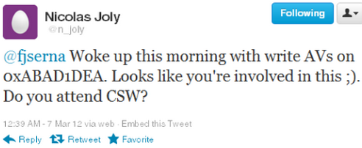
Do somebody else’s work
Notes:
Again: “The entity with the highest benefit-cost ratio”..
Although a noble intent it really attracts free-riding behavior
Besides, most of the times is actually not very productive/useful (look what happened after the flash allocator patch in Chrome → tons of people complaining about their flash crashing)

Slide 19
“Reactive security”
iOS jailbreaking saga has a primary example
Notes:
Reactive security, especially in enterprise settings, represents a significant bad externality that has long lasting consequences.
Think Java and IE6 and how hard it is for enterprises to get rid of those two.
Again, a case of bad externality

Slide 20
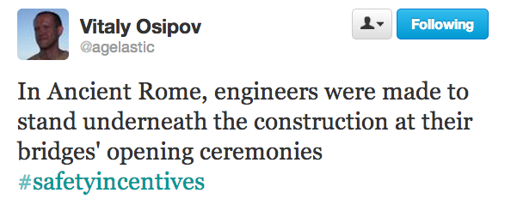
Lack of devs accountability
Notes:
This is another case of completely misaligned incentives
How many companies tie their developers’ bonuses to the bonuses of their AppSec people?

Slide 21
Stuff that works today
Notes:
It’s not all bad, we actually have good stuff happening too

Slide 22
Bug hunting
HAVOC/HAVOC-LITE (Julien Vanegue et al)
Bochspwn (Jurczyk et al)
Notes:
Automated solutions, geared towards finding specific sub-classes of bugs. The goal should be to make bug-finding a commodity

Slide 23


BlueHat prize/Pwnium/Pwn2Own
Bugs
Techniques
Notes:
All these contests allow companies to gain insight.
These are also great ways to cut on personnel and R&D costs

Slide 24
Some tools
EMET
…
?
?
?
Notes:
Effective, cheap and real-world oriented tools like EMET. We need more of these
EMET and the like create a good externality for enterprises and vendors alike

Slide 25
Let’s talk about tomorrow

Slide 26
Meditation interlude
Please pause for a second and contemplate what it means from a technical and sophistication POV for someone to backdoor NIST standards
Notes:
Regardless of who the actor is, the sophistication the industry is ready to tackle today is nowhere where it should be.

Slide 27
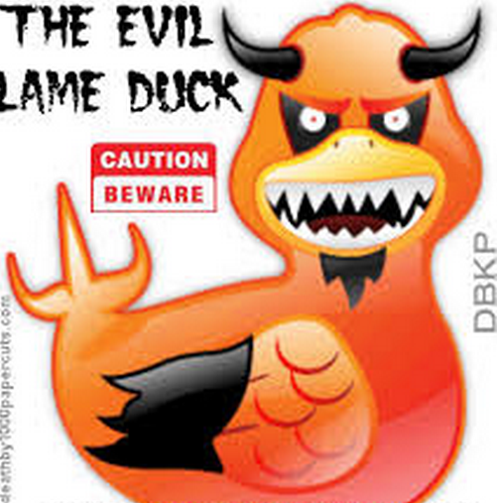

A line in the sand
If you want to fight this…
This has to go…
Notes:
If the goal is to actually tackle sophisticated attackers (eg: it’s not just a PR campaign) then the basic/lame APTs need to become somebody else’s problem.
As long as vendors spend time trying to cover for free-riders in the industry, they will never be able to tackle sophisticated attackers.
there’s very little vendors can do to help negligent companies besides taking the blame and doing more ‘miracle’ work

Slide 28

Warning

Slide 29
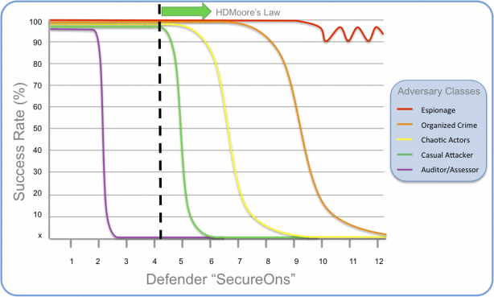
Proposal 1
Make AppSec risk understandable by non-infosec people/investors
Notes:
As long as investors don’t understand the field, AppSec will always be perceived as an externality and there will be no effect whatsoever on the market (and on newspapers) whenever a breach is discovered.
Really 99% of the breaches discovered were very basic, that’s in my book negligence on the breached company side. Also if such lame hack attempts succeeded
you should give for granted that more sophisticated actors have already breached the company (and potentially maintained persistence on their network).
This should be a red-herring sign for investors, but nobody explained this to them
For the longest time people hide behind the complexity of quantifying data in this field, these days we have significantly more data

Slide 30
You can start from this
 | Elderwood | NYU-Poly | Davis
Plugins Required | Flash, Office, Java | .NET | None
Version Support | IE8 / Win XP | IE8 / Win7 | IE9 / Win7
Reliability | ~50% | ~95% | ~99%
Features | Hardcoded ROP | Hardcoded ROP | Dynamic ROP
Time to Develop | ? (probably 8 hrs) | ~5 days | ~10 days
Experience | Professional | Amateur | Amateur
Notes:
If elderwood attacks you, really you have no excuses to call this a sophisticated hack
The sophistication of most of the exploits used by some APT groups is replicable by ComSci folks w/ no prior experience in a very short period of time.
How’s that for a ‘complexity’ benchmark?

Slide 31
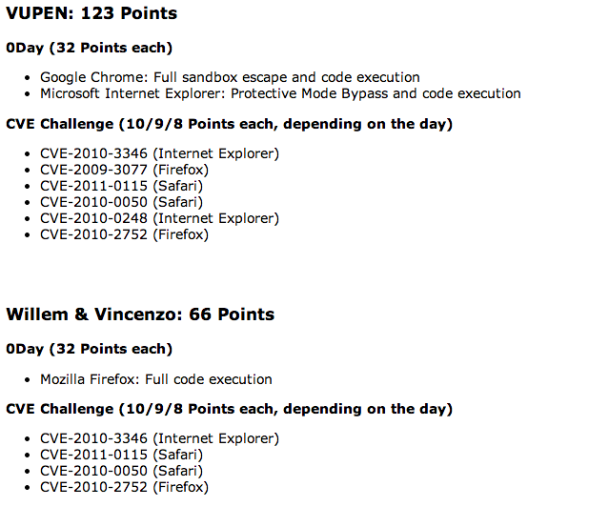
And this
Notes:
“People with a clue” can produce 4/6 exploits of similar quality in less than 2 days, again how’s that for sophistication?

Slide 32
Proposal 2
Make bug-hunting a commodity by creating appropriate tools. Focus on the errors your developers make
Notes:
A lot of companies are over-staffed with code auditors, that’s a waste of resources. They should focus on specific bug patterns and then come up with automated solutions to spot them

Slide 33

Proposal 3
Engage researchers/firms in DARPA CFT-like ways
Notes:
A lot of the actual ‘advanced’ problems are very hard to solve. Engaging firms in CFT-like ways gives you the ability to fund research that you only end up paying if the consultant delivers on a monthly basis.

Slide 34
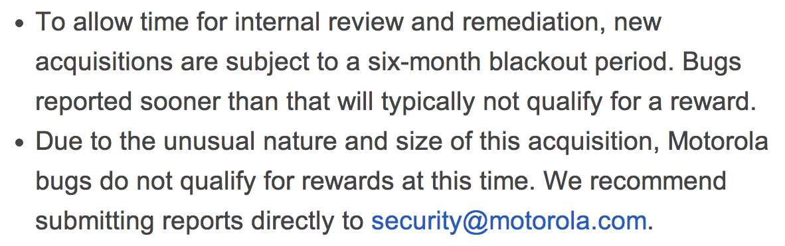
Proposal 4
Talk to your CFO and make security an integral factor in M&A activities
Notes:
Yup. 6-months before the code is on par
According to a EY’s survey only 21% of M&A had an IT due diligence process in place. Let alone security
Imagine a world where one of the factors to set the acquisition price is code-quality

Slide 35
Proposal 5
Do your own internal offensive research, it builds intuition and it makes for great ‘pro-active’ mitigations

Slide 36
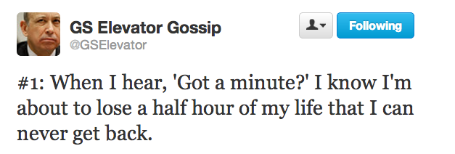
Conclusions

Slide 37
AppSec can and should become a profit-center
If we don’t do anything policy-makers will and we’re not going to like it
Insane amount of money is being poured in InfoSec, let’s not ruin this by fostering lemons
Freeriding is why we can’t have nice things
Notes:
Intel for instance is trying to get there with the new addition to its instruction set.
Outside of AppSec security is perceived as a potential profit-center (see for instance Cisco acquisition of SourceFire)
The ‘standard’ solution to the market for lemons and to free-riders is regulation.
Ask the financial sector how well regulation worked for me. Really that’s the worst possible outcome. Also the propaganda on China and their attacks doesn’t help at all in that direction
Investors are more and more interested in security, on the other hand they often invest in very lame products. The risk there is that InfoSec becomes a market for lemons for them and they’ll get out

Slide 38
Final quote
"Mass markets demand security, along with safety and reliability, only after the product becomes commoditized."
- Alex Gantman
Notes:
We’ve been selling software for decades now, that’s enough time to reach ‘maturity’. Now it’s really time to sell security and safety

Slide 39
Thanks! Questions?
vincenzo@trailofbits.com

